Slide 1

Chapter 1 - Database Systems
minhvd @ MFE - ORLab
Database System Design, Implementation And Management

Slide 2
Content
General Information
Program Educational Objectives (PEOs)
Student Outcomes (SOs) and Performance Indicators (PIs)
2022-2023 Assessment Plan & Results
2023-2024 Assessment Plan

Slide 3
Chapter goals
Define the difference between data and information
Describe what a database is, the various types of databases, and why they are valuable assets for decision making
Explain the importance of database design
See how modern databases evolved from file systems

Slide 4
Chapter goals (cont’)
Understand flaws in file system data management
Outline the main components of the database system
Describe the main functions of a database management system (DBMS)

Slide 5
1-1 Why Databases?
Data is ubiquitous (abundant, global, everywhere) and pervasive (unescapable, prevalent, persistent).
From birth to death, we generate and consume data.
Data is essential for organizations to survive and prosper
Activities: collection, storage, aggregation, manipulation, dissemination, and management of data

Slide 6
1-1 Why Databases?
Databases are the best way to store and manage data.
Databases make data persistent and shareable in a secure way.

Slide 7
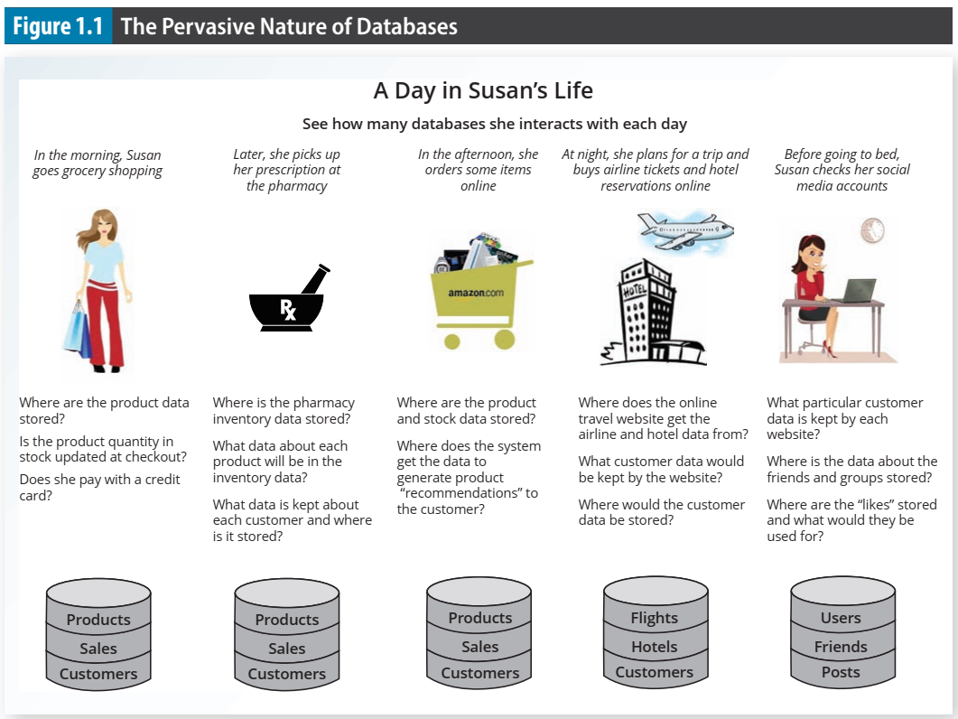

Slide 8
Program Educational Obectives (PEOs)
The IT Program expects the graduates within a few years (3 to 5 years) of graduation to attain the following:
PEO1: Our graduates will engage in the productive practice of implementing computer-based systems across a broad range of application areas.
PEO2: Our graduates have successful careers in industry or academia, providing leadership for their profession.
PEO3: Our graduates will be filling the technical needs of society by solving technical problems with professional and ethical manners.

Slide 9
SOs and PIs of IT Program
The SOs of the IT Program are the same as those required by ABET for any IT program to receive accreditation. The IT graduates will have an ability to:
Student Outcome | Description
SO1 | Analyze a complex computing problem and apply principles of computing and other relevant disciplines to identify solutions.
SO2 | Design, implement, and evaluate a computing-based solution to meet a given set of computing requirements in the context of the program's discipline.
SO3 | Communicate effectively in a variety of professional contexts.
SO4 | Recognize professional responsibilities and make informed judgments in computing practice based on legal and ethical principles.
SO5 | Function effectively as a member or leader of a team engaged in activities appropriate to the program's discipline.
SO6 | Use systemic approaches to select, develop, apply, integrate, and administer secure computing technologies to accomplish user goals (IT).

Slide 10
SOs and PIs of CS Program
The SOs of the CS Program are the same as those required by ABET for any CS program to receive accreditation. The CS graduates will have an ability to:
Student Outcome | Description
SO1 | Analyze a complex computing problem and apply principles of computing and other relevant disciplines to identify solutions.
SO2 | Design, implement, and evaluate a computing-based solution to meet a given set of computing requirements in the context of the program's discipline.
SO3 | Communicate effectively in a variety of professional contexts.
SO4 | Recognize professional responsibilities and make informed judgments in computing practice based on legal and ethical principles.
SO5 | Function effectively as a member or leader of a team engaged in activities appropriate to the program's discipline.
SO6 | Apply computer science theory and software development fundamentals to produce computing-based solutions (CS).

Slide 11
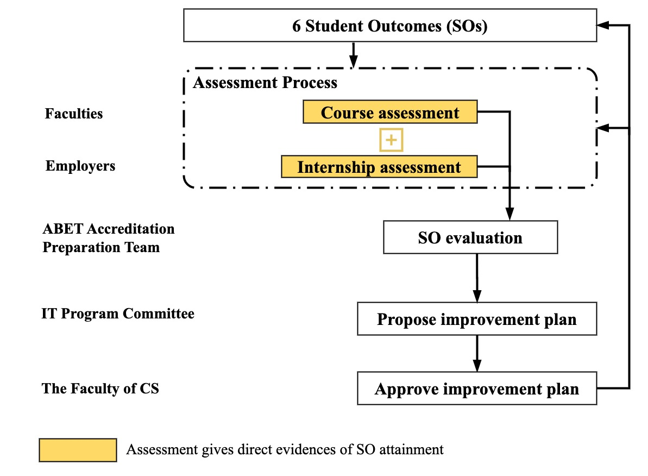
Continuous Improvement Process
SOs are assessed and reviewed annually
IT Program
CS Program

Slide 12
SOs and PIs of IT Program
Performance Indicators (PIs) are developed as the common measurement of SO attainment across different courses
SOs | PIs for SOs
(1) Analyze a complex computing problem and apply principles of computing and other relevant disciplines to identify solutions. | 1.1 Student will be able to analyze a complex computing problem.
 | 1.2 Student will be able to apply computing principles and other relevant disciplines to identify solutions.
(2) Design, implement, and evaluate a computing based solution to meet a given set of computing requirements in the context of the program's discipline. | 2.1 Students will be able to design computer-based solutions for a given problem.
 | 2.2 Students will be able to implement and evaluate the designed solutions for a given problem.
(3) Communicate effectively in a variety of professional contexts. | 3.1 Students will be able to produce a variety of documents for technical and non-technical audiences.
 | 3.2 Students will be able to prepare and deliver oral presentations.
(4) Recognize professional responsibilities and make informed judgments in computing practice based on legal and ethical principles. | 4.1 Students will be able to identify professional, legal and ethical issues.
 | 4.2 Students will be able to determine their responsibilities in professional, legal and ethical issues.
(5) Function effectively as a member or leader of a team engaged in activities appropriate to the program's discipline. | 5.1 Students will be able to articulate and interpret the collaborative work of the team.
 | 5.2 Students will be able to fulfill duties of team roles.
(6) Use systemic approaches to select, develop, apply, integrate, and administer secure computing technologies to accomplish user goals. | 6.1 Students will be able to select, develop and apply appropriate secure computing technologies to meet user goals.
 | 6.2 Students will be able to integrate and administer secure computing-based technologies.

Slide 13
SOs and PIs of CS Program
Performance Indicators (PIs) are developed as the common measurement of SO attainment across different courses
SOs | PIs for SOs
(1) Analyze a complex computing problem and apply principles of computing and other relevant disciplines to identify solutions. | 1.1 Student will be able to analyze a complex computing problem.
 | 1.2 Student will be able to apply computing principles and other relevant disciplines to identify solutions.
(2) Design, implement, and evaluate a computing based solution to meet a given set of computing requirements in the context of the program's discipline. | 2.1 Students will be able to design computer-based solutions for a given set of computing requirements.
 | 2.2 Students will be able to implement and evaluate the designed solutions for a given problem.
(3) Communicate effectively in a variety of professional contexts. | 3.1 Students will be able to produce a variety of documents for technical and non-technical audiences.
 | 3.2 Students will be able to prepare and deliver oral presentations.
(4) Recognize professional responsibilities and make informed judgments in computing practice based on legal and ethical principles. | 4.1 Students will be able to identify professional, legal and ethical issues.
 | 4.2 Students will be able to determine their responsibilities in professional, legal and ethical issues.
(5) Function effectively as a member or leader of a team engaged in activities appropriate to the program's discipline. | 5.1 Students will be able to articulate and interpret the collaborative work of the team.
 | 5.2 Students will be able to fulfill duties of team roles.
(6) Use systemic approaches to select, develop, apply, integrate, and administer secure computing technologies to accomplish user goals. | 6.1 Students will be able to demonstrate and apply knowledge of mathematical functions to analyze a given algorithm
 | 6.2 Students will be able to apply software development fundamentals to produce computing-based solutions.

Slide 14
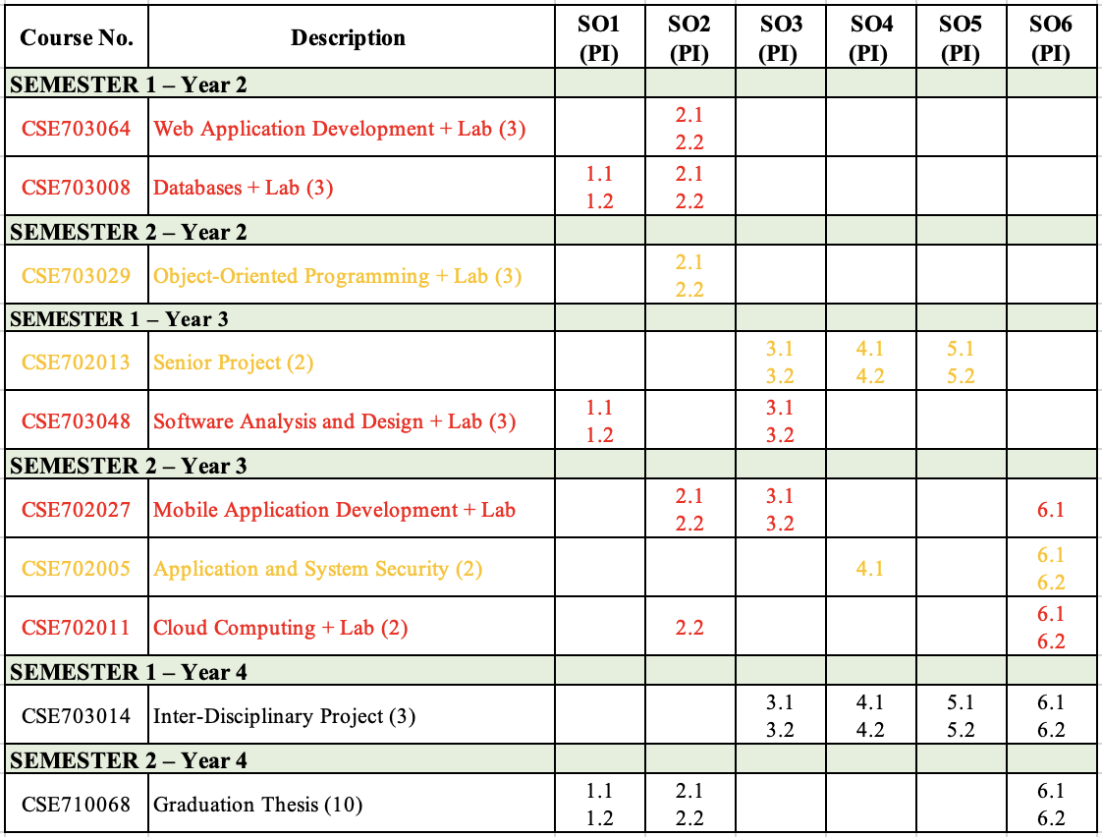
Key Courses for Assessment (IT)
Has assessment data
Delivered, gathering data
Not yet delivered

Slide 15
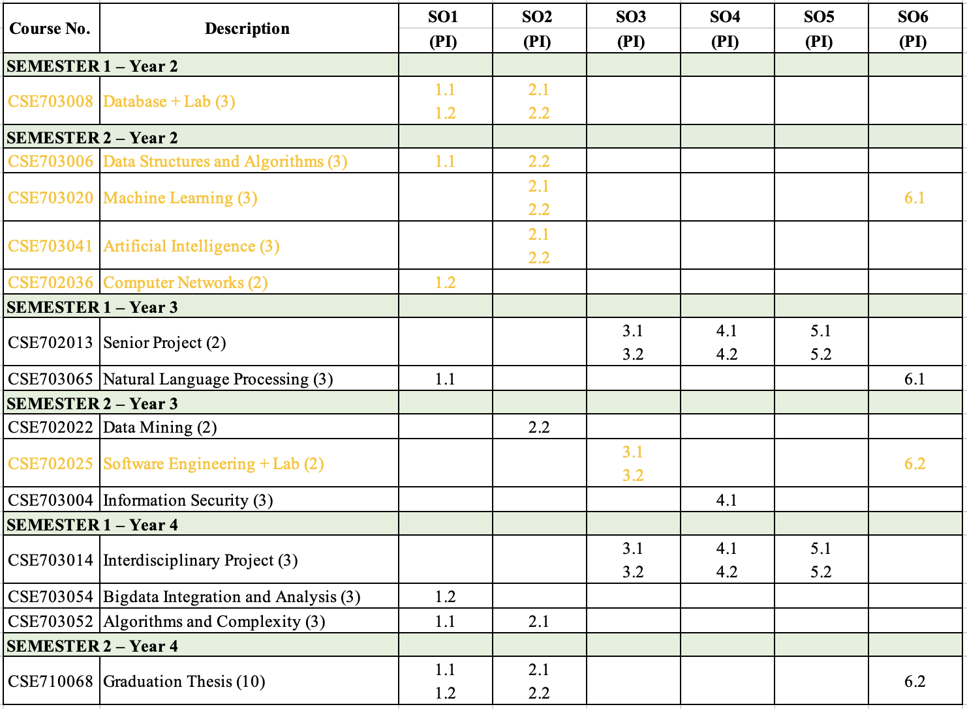
Key Courses for Assessment (CS)
Has assessment data
Delivered, gathering data
Not yet delivered

Slide 16
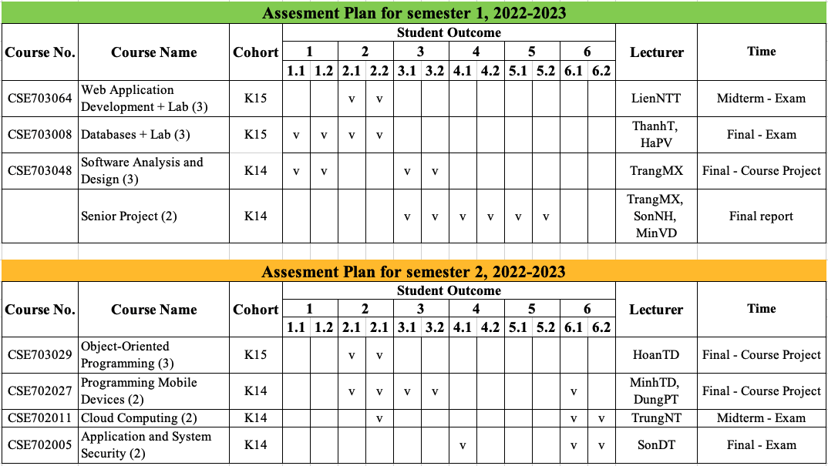
2022-2023 Assessment Plan (IT)

Slide 17
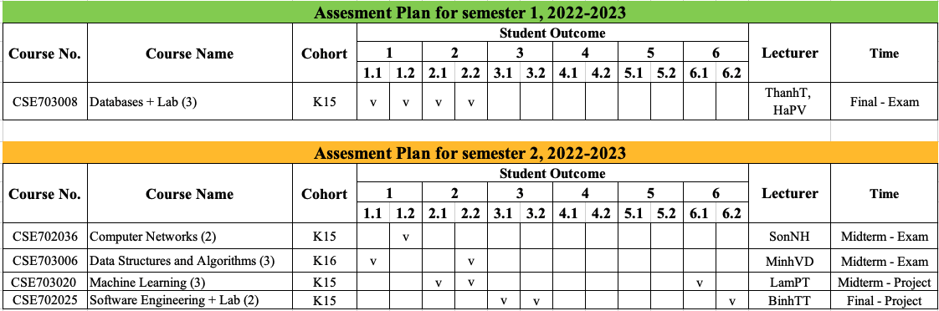
2022-2023 Assessment Plan (CS)

Slide 18
Assessment Results (IT)
Student Outcomes

Slide 19
Assessment Results (IT)
Student Outcomes
SOs | % Meet
(1) Analyze a complex computing problem and apply principles of computing and other relevant disciplines to identify solutions. | 47,9%
(2) Design, implement, and evaluate a computing-based solution to meet a given set of computing requirements in the context of the program's discipline. | 52,7%
(3) Communicate effectively in a variety of professional contexts. | 73,7%
(4) Recognize professional responsibilities and make informed judgments in computing practice based on legal and ethical principles. | 29,9%
(5) Function effectively as a member or leader of a team engaged in activities appropriate to the program's discipline. | 79,9%
(6) Use systemic approaches to select, develop, apply, integrate, and administer secure computing technologies to accomplish user goals (IT). | 41,1%

Slide 20
Assessment Results (IT)
Performance Indicators

Slide 21
Assessment Results (IT)
SOs | PIs for SOs | % Meet
SO1 | 1.1 Student will be able to analyze a complex computing problem. | 49,8%
 | 1.2 Student will be able to apply computing principles and other relevant disciplines to identify solutions. | 46,0%
SO2 | 2.1 Students will be able to design computer-based solutions for a given problem. | 51,8%
 | 2.2 Students will be able to implement and evaluate the designed solutions for a given problem. | 53,3%
SO3 | 3.1 Students will be able to produce a variety of documents for technical and non-technical audiences. | 72,4%
 | 3.2 Students will be able to prepare and deliver oral presentations. | 75,0%
SO4 | 4.1 Students will be able to identify professional, legal and ethical issues. | 31,8%
 | 4.2 Students will be able to determine their responsibilities in professional, legal and ethical issues. | 28,0%
SO5 | 5.1 Students will be able to articulate and interpret the collaborative work of the team. | 75,7%
 | 5.2 Students will be able to fulfill duties of team roles. | 84,1%
SO6 | 6.1 Students will be able to select, develop and apply appropriate secure computing technologies to meet user goals. | 61,5%
 | 6.2 Students will be able to integrate and administer secure computing-based technologies. | 15,1%
Notes:
PI: chỉ số đánh giá

Slide 22
Assessment Results (IT)
Performance Indicators

Slide 23
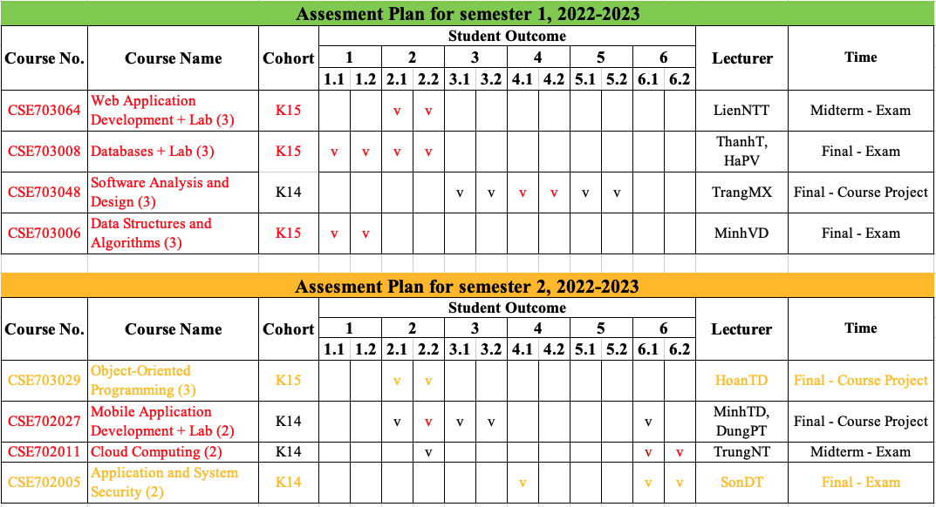
Assessment Results (IT)
Performance Indicators

Slide 24
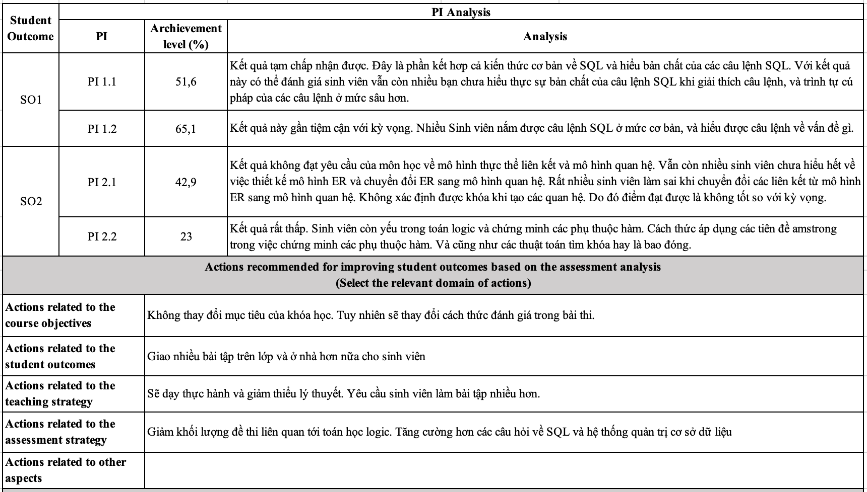
Analysis & Recommendation from Courses
Analysis and comments from CSE703038 – Databases

Slide 25
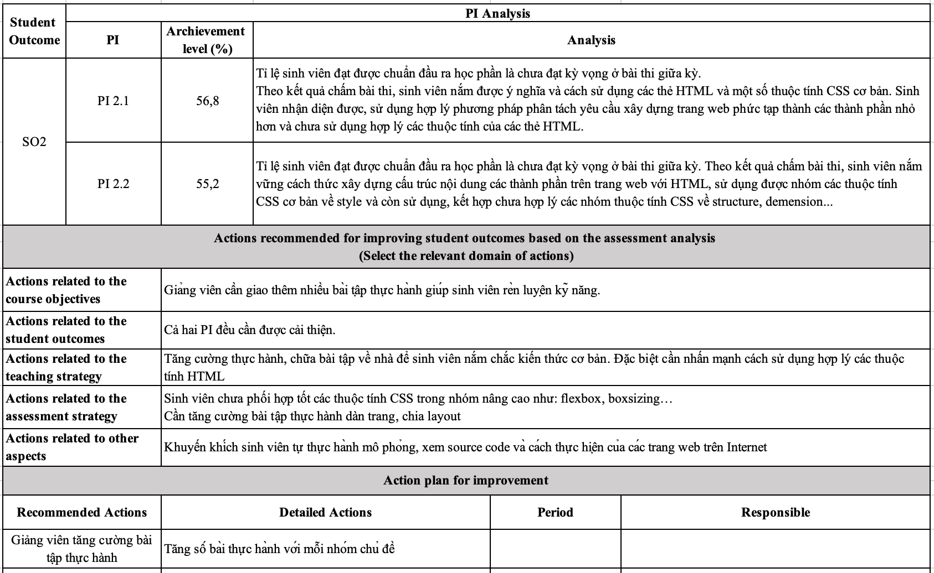
Analysis & Recommendation from Courses
Analysis and comments from CSE703064 – Web Application Development

Slide 26
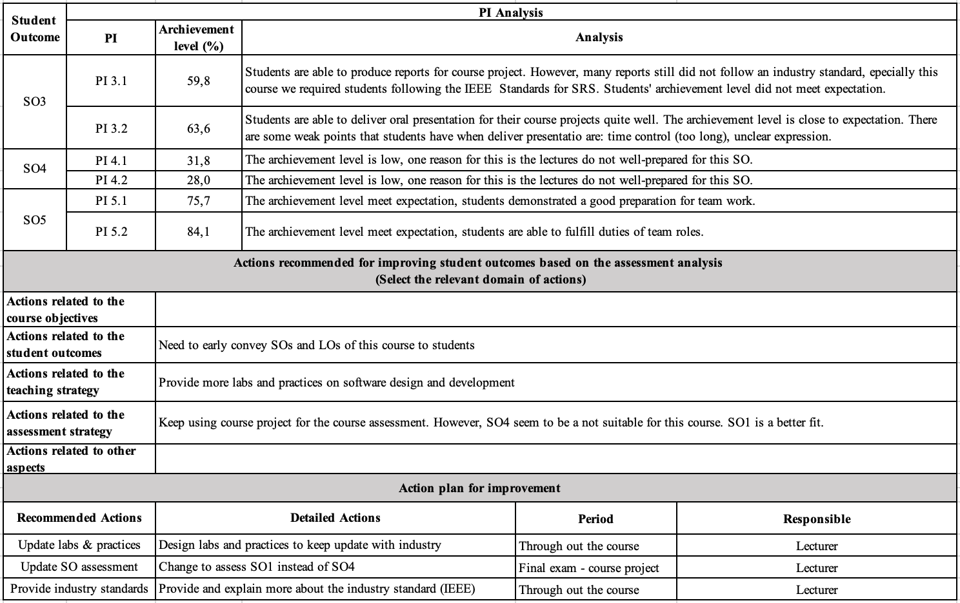
Analysis & Recommendation from Courses
Analysis and comments from CSE703048 – Software Analysis and Design

Slide 27
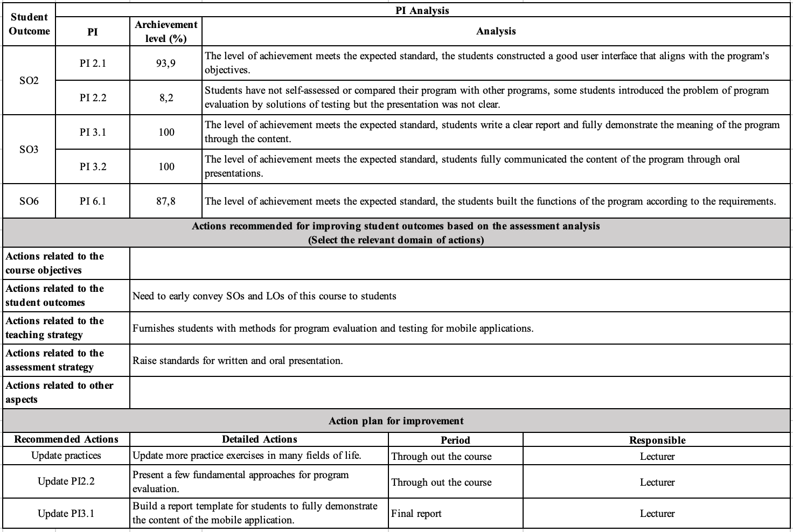
Analysis & Recommendation from Courses
Analysis and comments from CSE702027 – Mobile Application Development

Slide 28
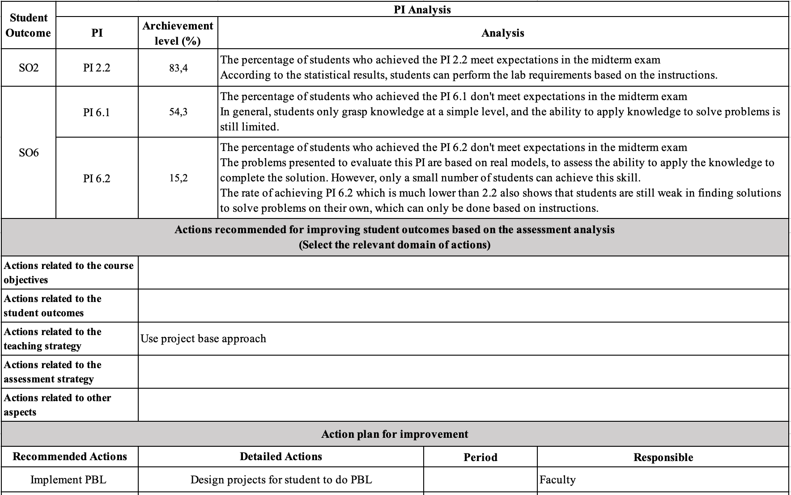
Analysis & Recommendation from Courses
Analysis and comments from CSE702011 – Cloud Computing

Slide 29
Recommendation for Program
Improve the results of SO1:
Use different and senior courses to assess
Improve the results of SO2:
Use different and senior courses to assess
Improve the results of SO3:
Improve rubrics
Improve the results of SO4:
Topics on professional, legal and ethical issues should be provided in the “Introduction to Computing” course
Topics on professional, legal and ethical issues should added in project courses

Slide 30
Recommendation for Program
Improve the results of SO5:
Improve rubrics
Improve the results of SO6:
Secure computing topics need to be integrated into several courses in the program
More actions will be discussed in the faculty meeting.

Slide 31
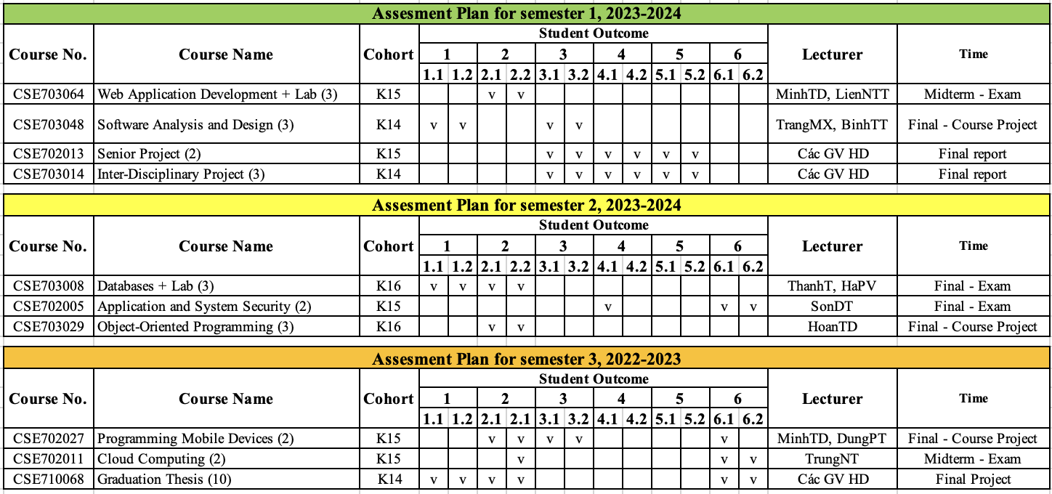
Assessment Plan for 2023-2024 (IT)

Slide 32
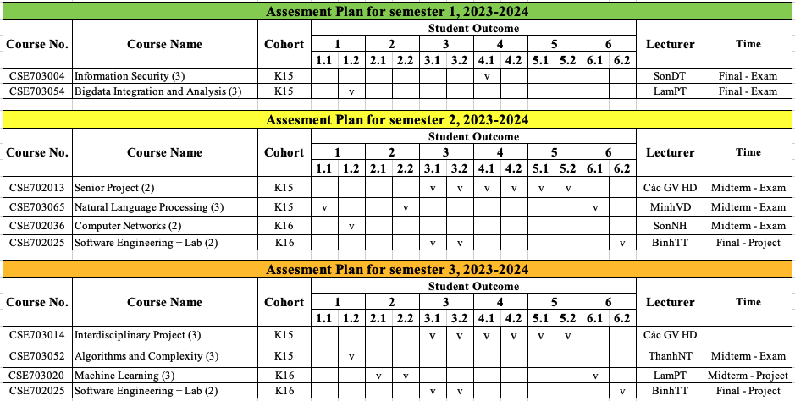
Assessment Plan for 2023-2024 (CS)

Slide 33
Thank you! Have a great academic year!

